Slide 1
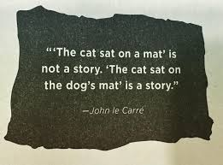

Slide 2
Great Slide Decks
A great slide deck is half the battle won.

Slide 3
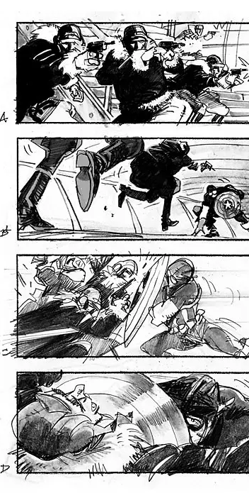
1. Storyboard your Presentation
What is your main idea in 10 words or less?
What are the stories you can insert into the presentation?
What is the beginning? Middle? End?
Will your audience understand this story?

Slide 4

2. A Picture (or chart) tells a Thousand Words
What visuals tell the story?
What charts tell the story?
Maximize visuals. Minimize text.
If the audience takes your deck home, will they understand the story?

Slide 5


Slide 6
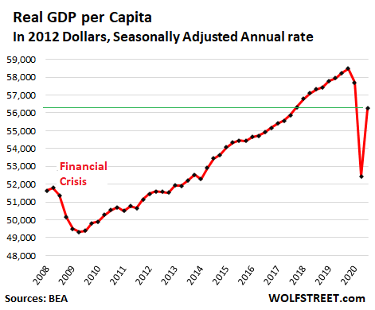

Slide 7
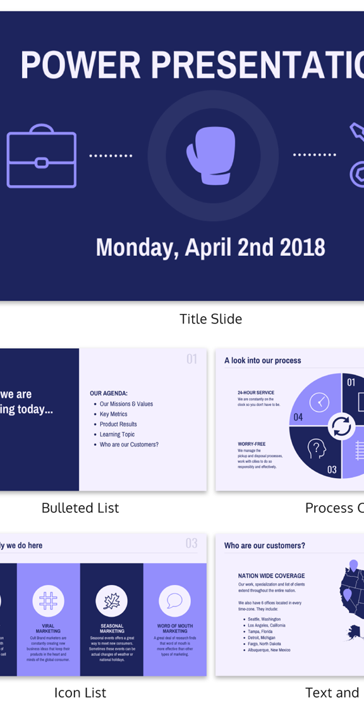
3. Text
Use San Serif fonts
Use only 1 or 2 fonts
Make certain there is contrast between text and background
Use white space in visuals for text

Slide 8
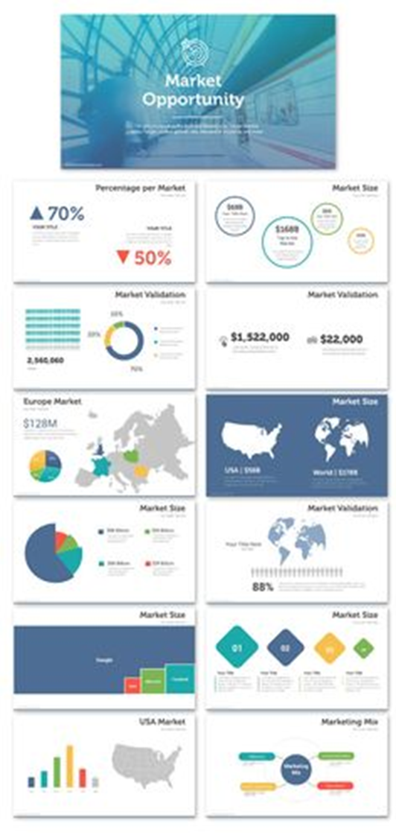
4. Charts and Diagrams
Make labels clear.
What is your core point? Make it big and bold.
Consider building the chart, emphasizing your core point.

Slide 9
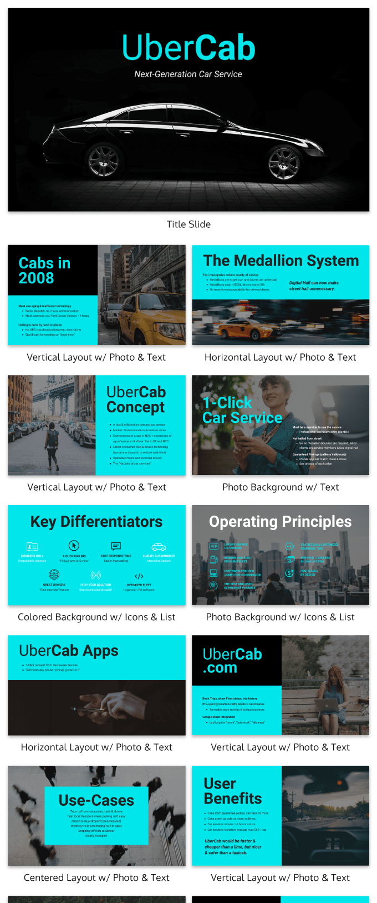
5. Examples
https://presentationstemplate.com/slide-deck/market-opportunity
https://venngage.com/blog/best-pitch-decks/
https://launchpad.syr.edu/wp-content/uploads/2022/08/Pitch-deck-template-7.26.2022-updated-layout.pdf

Slide 10
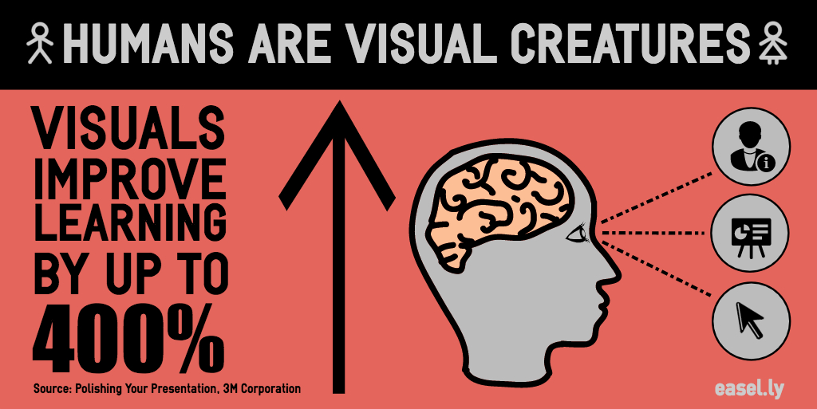
6. Common Mistakes
Too many visuals per slide – Use one visual, one chart, or one diagram per slide
Low quality visuals – pixelated pictures, poor editing
Too much text, reading your text
Slides for the room – ballroom, boardroom, virtual presentations – make certain the back of the room can see your slides and read the text and charts

Slide 11

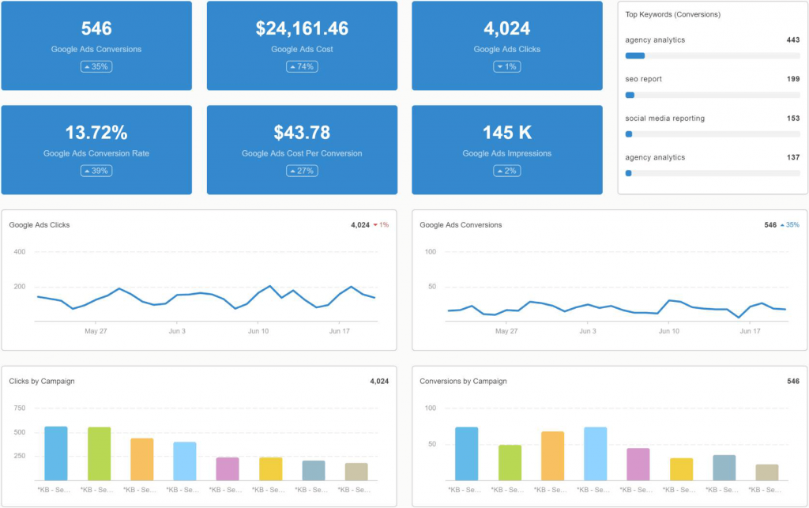
Dashboards and Virtual Presentations

Slide 12
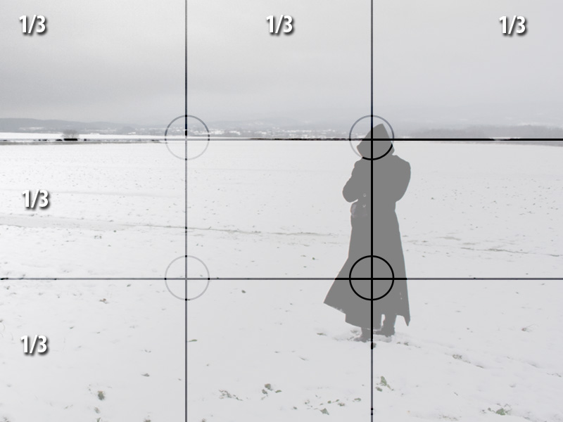
The Power of Thirds
Notes:
Visuals, graphs matter.

Slide 13

LaunchPad
Introduction
Team/Advisors
Problem Validation
Solution/Value Proposition
Competitive Landscape
Intellectual Property
Marketing
Sales
Operations
Projected Revenues and Expenses
Product and Financial Roadmap
The Ask
Summary
Contact Information

Slide 14
